Slide 1
40 years of innovation in green sample preparation at RIC
Tatiana Cucu, Christophe Devos, Koen Sandra & Pat Sandra
2nd Green Analytical Chemistry Workshop
2nd of February 2026

Slide 2
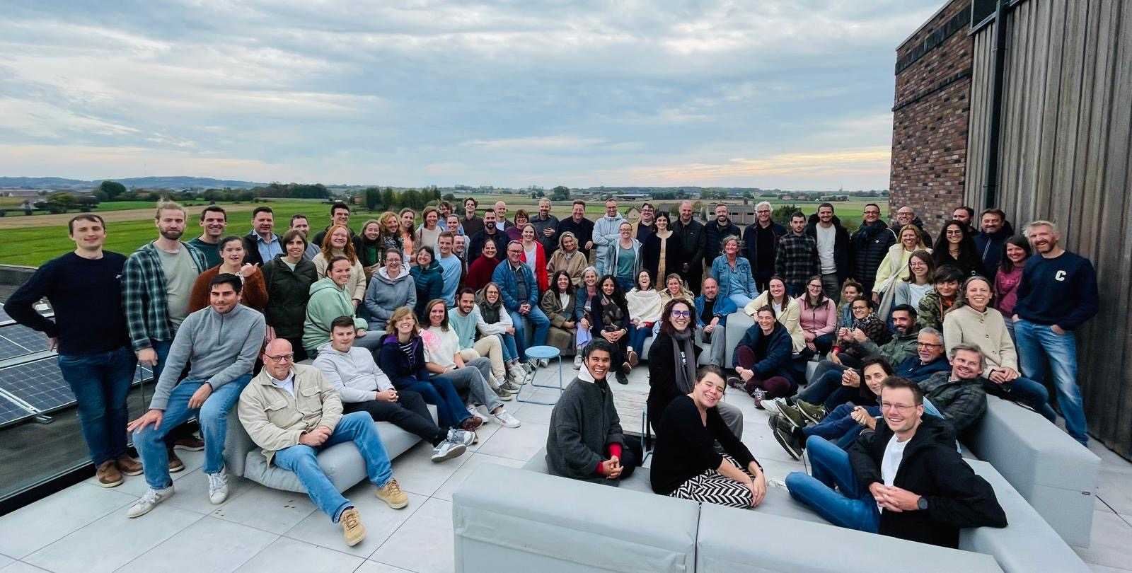
Introduction to RIC group
Privately owned European R&D partner in the field of analytical solutions mainly based on chromatography and electrophoresis in combination with mass spectrometry
Supporting customers worldwide in various industries with scientific know-how & technical expertise for 40 years
Founded by Prof. Pat Sandra in 1986
Now headed by Tom & Koen Sandra
Based in Belgium (Kortrijk)
French subsidiary (Lyon)
New state-of-the art facility since 2023

Slide 3
Introduction to RIC group
Privately owned European R&D partner in the field of analytical solutions mainly based on chromatography and electrophoresis in combination with mass spectrometry
Supporting customers worldwide in various industries with scientific know-how & technical expertise for 40 years
Founded by Prof. Pat Sandra in 1986
Now headed by Tom & Koen Sandra
Based in Belgium (Kortrijk)
French subsidiary (Lyon)
New state-of-the art facility since 2023

Slide 4
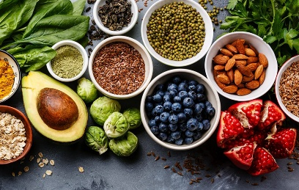
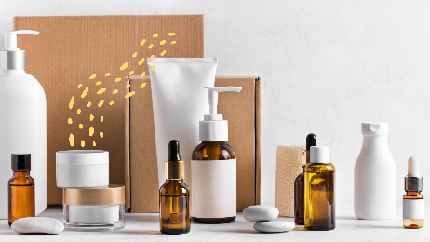


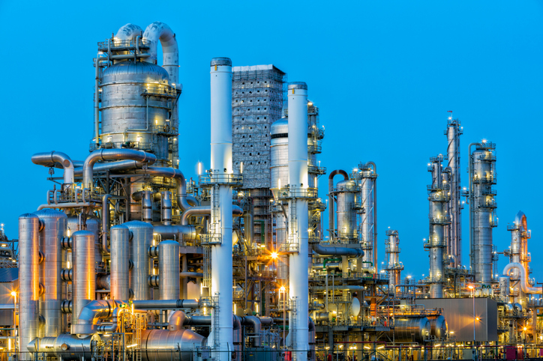
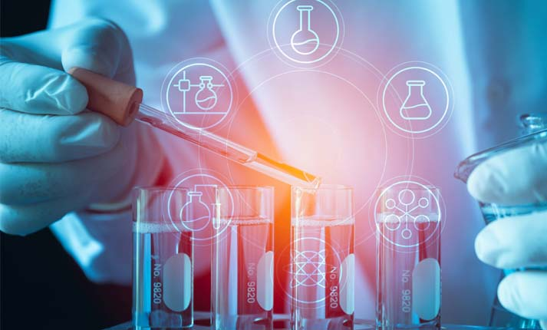
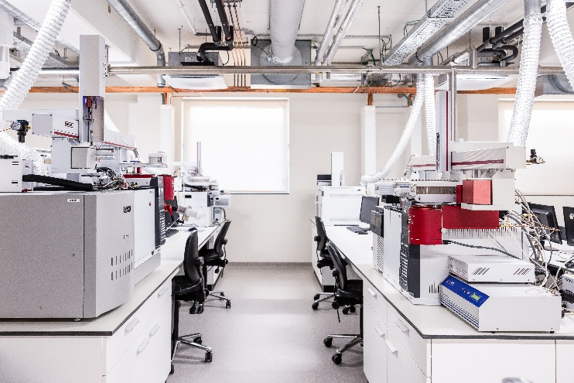
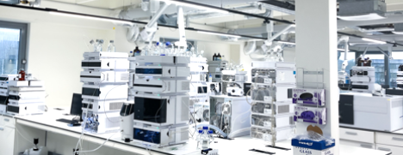
Our analytics
Sample preparation
Extraction/clean-up/preconcentration/
digestion/derivatization …
Small amounts of material
Separation
GC/LC/SFC/Electro-driven separations
Detection
MS(/MS), FID, UV, FLD, ELSD …
State-of-the-art equipment
Data/reporting
Data processing/reporting (quantification/ identification)
Statistical analysis

Slide 5
“The best sample preparation is no sample preparation”
Today state-of-the-art instrumentation is very powerful, but sample preparation often remains the critical step in an analysis.
Success of sample preparation depends on:
  Extraction efficiency (matrix removal)
  Purification (isolation or selective extraction)
  Enrichment (through preconcentration of diluted samples)

Slide 6

Green sample preparation at RIC
The 1999 Dioxin crisis in Belgium:
  Pat Sandra made the link between the dioxins and the PCBs (precursors)
  PCBs analysis in food – more simple, faster and cheaper
30 min extraction with 10 mL petroleum ether
5 mL extract + 1 g SiO₂ containing 44% H₂SO₄ is added to remove the lipidic fraction
  Mixing for 30 min
Centrifugation and analysis
50 samples per day/instrument

Slide 7
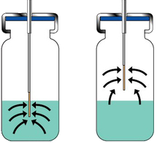
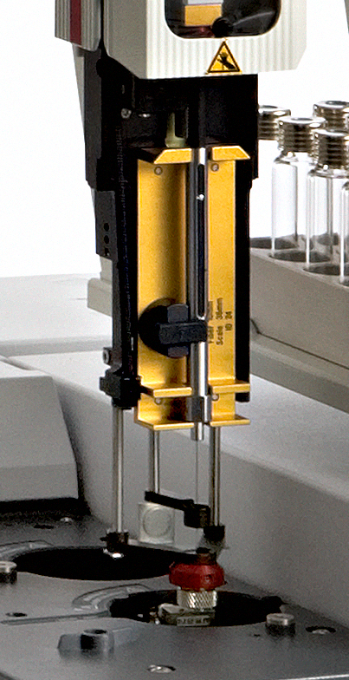

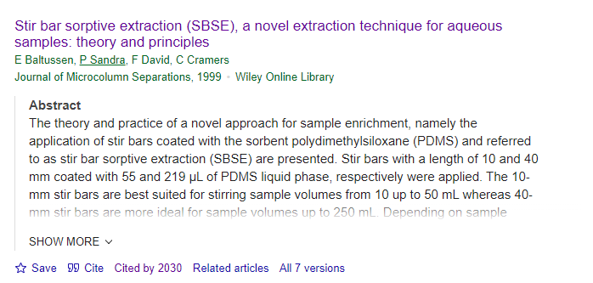
Green sample preparation at RIC
Solid Phase Microextraction (SPME) on a PDMS coated fused silica fiber:
  SPME followed by thermal desorption in a heated split/splitless injector (C.L. Arthur & J. Pawliszyn. Anal. Chem. 1990)
  Extraction of aqueous samples with a PDMS coated stir bar
    Baltussen E., Sandra P., David F., Cramers C (1999)

Slide 8
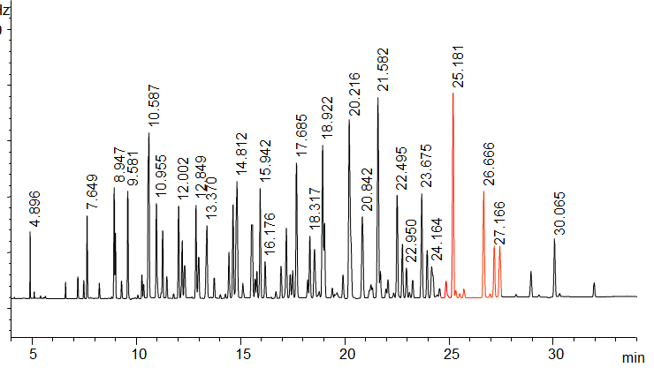
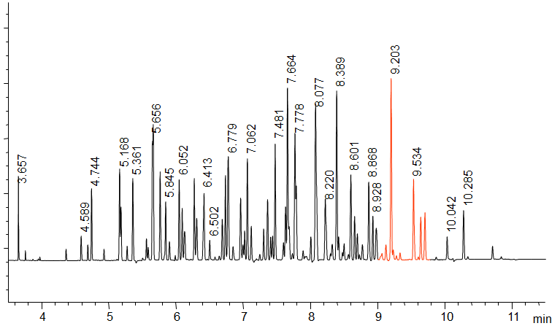
Why PDMS?
Best sorptive extraction medium:
  PDMS is known to be one of the best stationary phases (apolar) in capillary GC
  Unique thermal stability and inertness: 50 – 400 °C
Detailed PCBs analysis
Fast PCBs analysis
80 m x 0.1 mm ID x 0.1 µm df
25 m x 0.25 mm ID x 0.25 µm df
10 m x 0.1 mm ID x 0.1 µm df

Slide 9
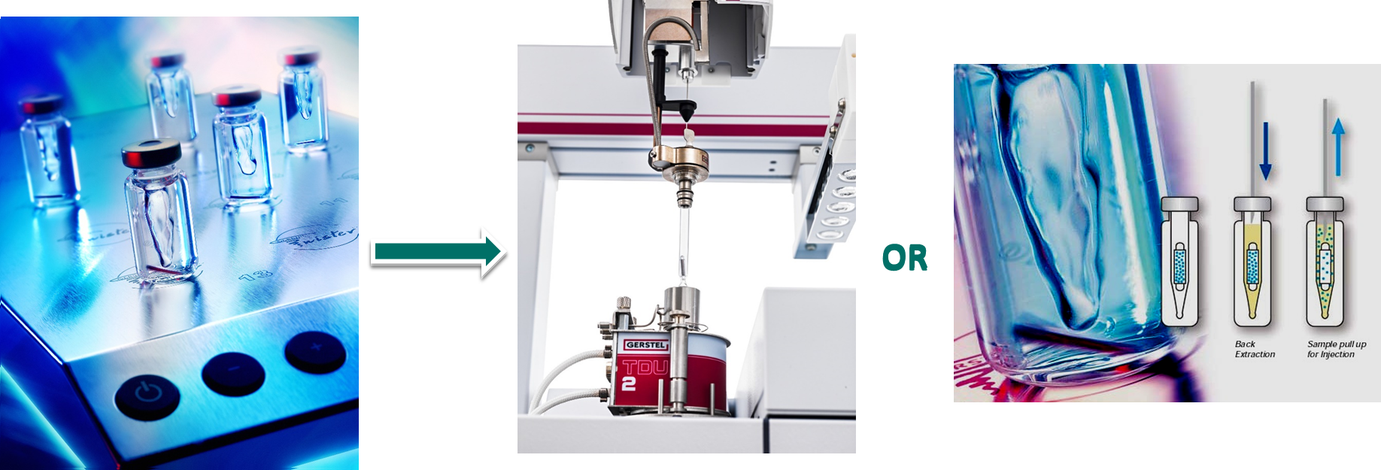
Solventless extraction and analysis

Slide 10
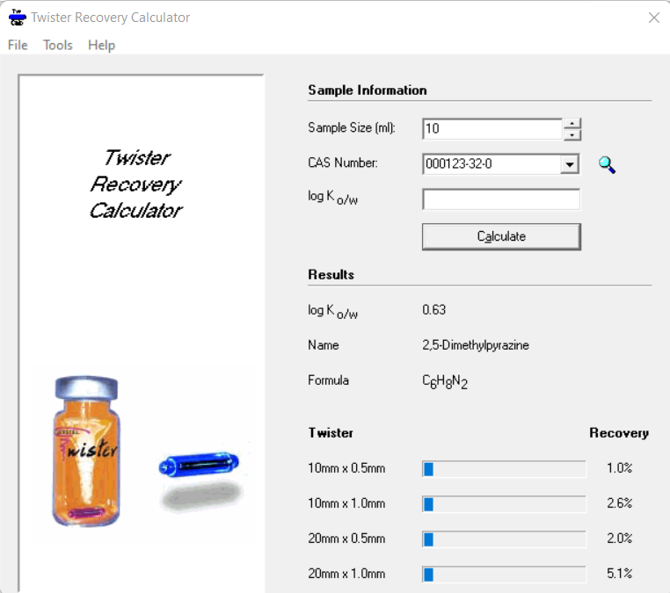
Recovery estimation
Predictable because PDMS/water distribution is similar to the octanol/water distribution
K_{o/w} can be used and if not available can be theoretically calculated
m_{SBSE}= amount on PDMS
m₀= initial amount
K_{ow} = octanol - water partitioning
β = phase ratio
Thiobencarb – Log K_{o/w :} 3.8971 (K_{o/w} = 10^{3.8971} = 7890)
SBSE
Twister: 24 µL PDMS
SPME
Fiber: 0.5 µL PDMS
Phase ratio β: 20 000
Phase ratio β: 416
Recovery: 95%
Recovery: 28%

Slide 11

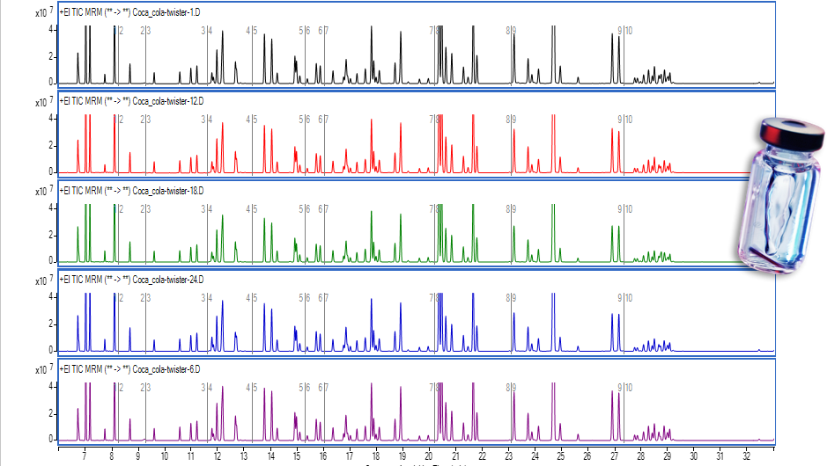
SBSE advantages
Green/solventless extraction technique
  Solventless = lower operational costs
Reduced staff exposure to hazardous solvents
Minimal sample manipulation and handling
  Can be used in the field for later analysis in an analytical lab
Can be re-used multiple times
Excellent repeatability and reproducibility
Sub ng/L sensitivity levels due to the higher volume of PDMS
Methods validated for many applications

Slide 12

Excellent repeatability
Sesquiterpene fraction (common ion m/z 161)
EIC of m/z 88 characteristic for the ethyl esters
Beer 1
β-Santanol acetate
Beer 2

Slide 13
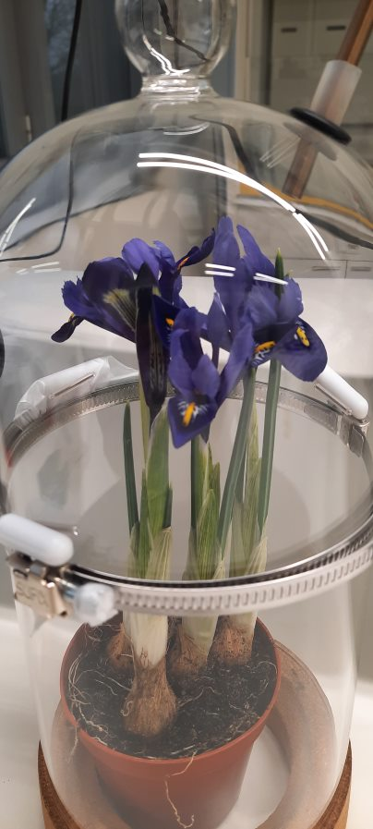
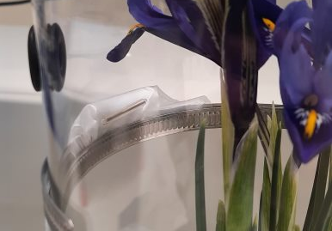


Sampling in the field

Slide 14
Sampling in the field?
β-Ocimene
Benzyl acetate
Benzenepropyl acetate
  Analysis 1: immediately after sampling
  Analysis 2: after 3 days storage at 4°C
  Analysis 3: after 6 days storage at 4°C

Slide 15
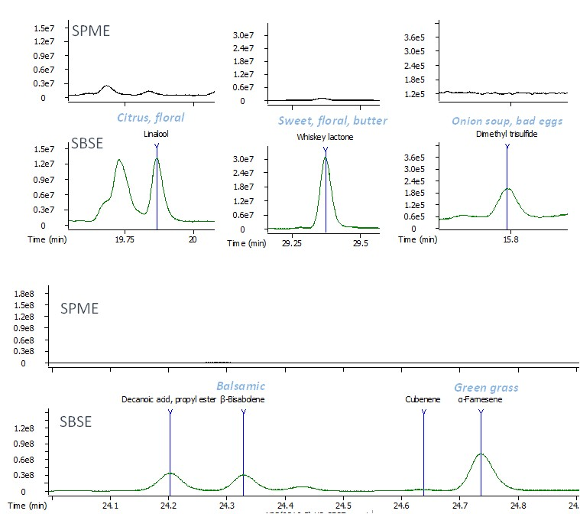
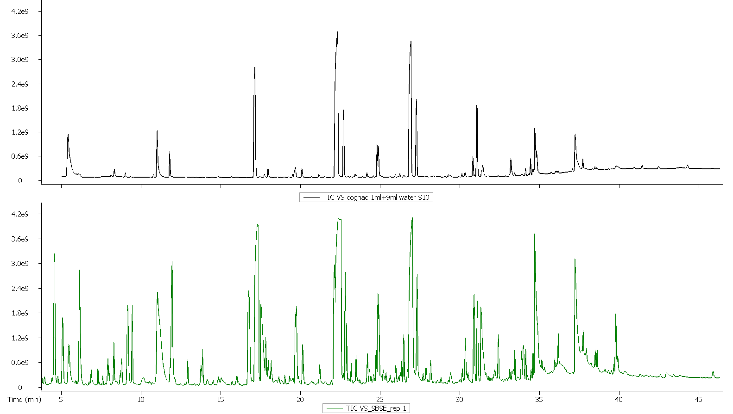
SPME vs SBSE
SPME
SBSE

Slide 16
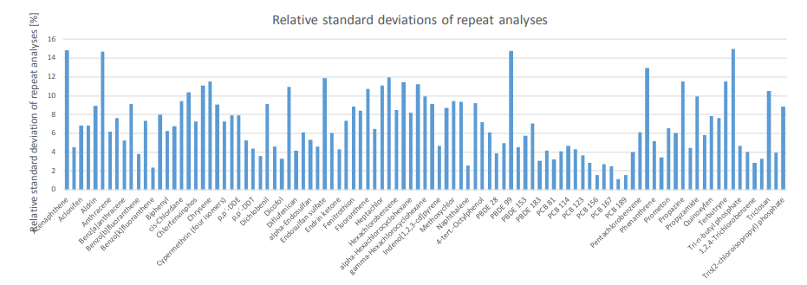
Water analysis
Most official methods use liquid-liquid extraction with high solvent volumes or SPE:
  Dual SBSE extraction – single shot GC-MS/MS
  pg/L sensitivities
Water spiked at LOQs (n=6)

Slide 17
Limitations?
Only PDMS ?
  Ongoing research in development of new phases (RIC group presentation Riva del Garda, Italy May 17-22, 2026)
Lack of extraction performance for polar compounds (log K_{o/w} < 2)
  Multiple/sequential SBSE extraction
  Salt addition
  Derivatization
  Addition of organic modifiers
  SA-SBSE

Slide 18
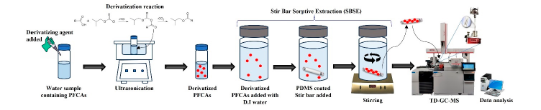
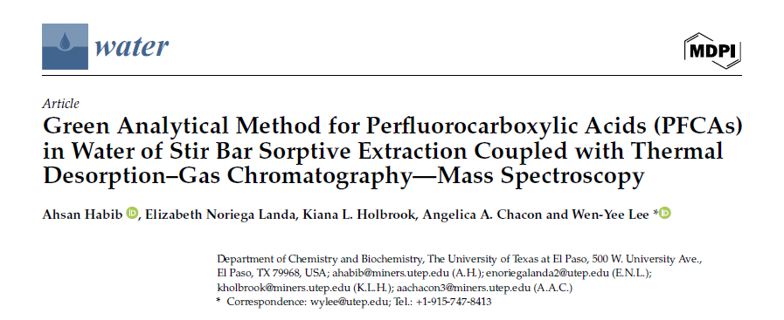
Analysis of PFAS?
Derivatization of perfluorocarboxylic acids by isobutyl chloroformate and SBSE extraction (Habib et al., 2024)
  Low ppt (ng/L) LOD obtained
  Excelent repeatability (below 15% at 100 ng/L)

Slide 19
Challenges in sample preparation
How to achieve high analytical performance with limited environmental impact?
Sample throughput/productivity
  Cost per sample
(Ultra-) trace analysis
Multiresidues
  All in one run (e.g. pesticides in food and environmental samples, mineral oil, allergens in cosmetics, etc)
  Extractables and leachables

Slide 20
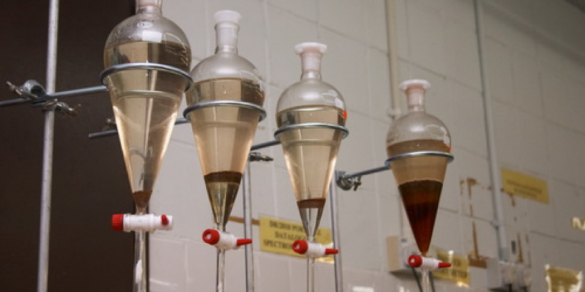
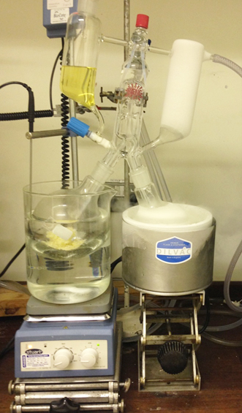
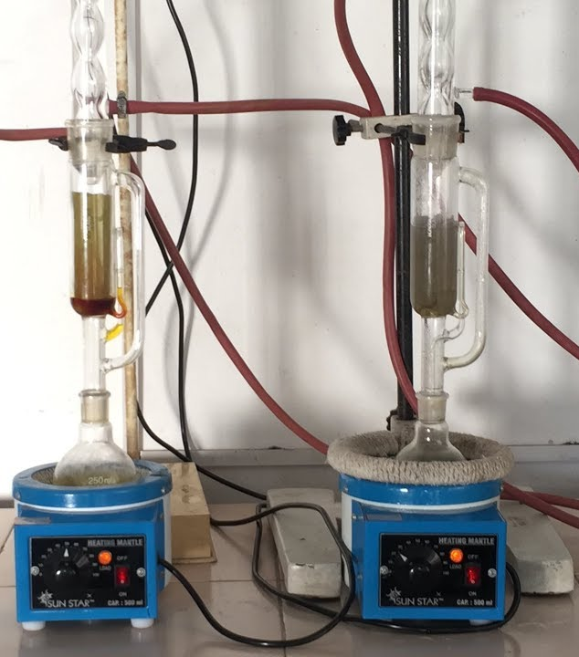
Conventional sample preparation techniques
Time-consuming (cumbersome extraction procedures, lengthy concentration steps, etc)
High consumption of reagents and sample
Waste generation
High cost per analysis
Prone to human errors
Operator’s safety?

Slide 21
Greener strategies in sample preparation
Reduce sample and solvent volume -> miniaturization
Minimize waste production
Use methods with higher extraction performance

Slide 22
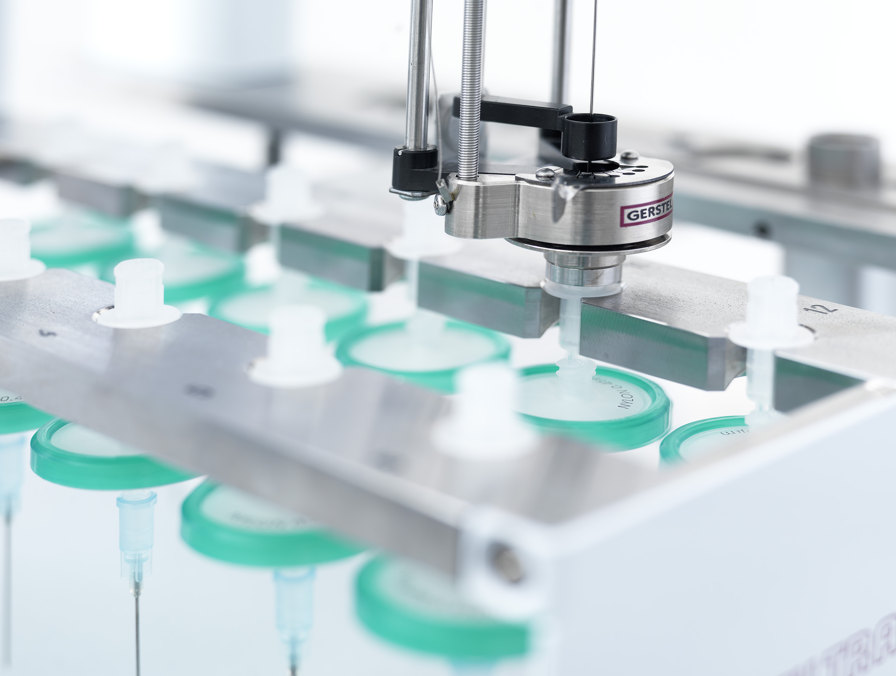
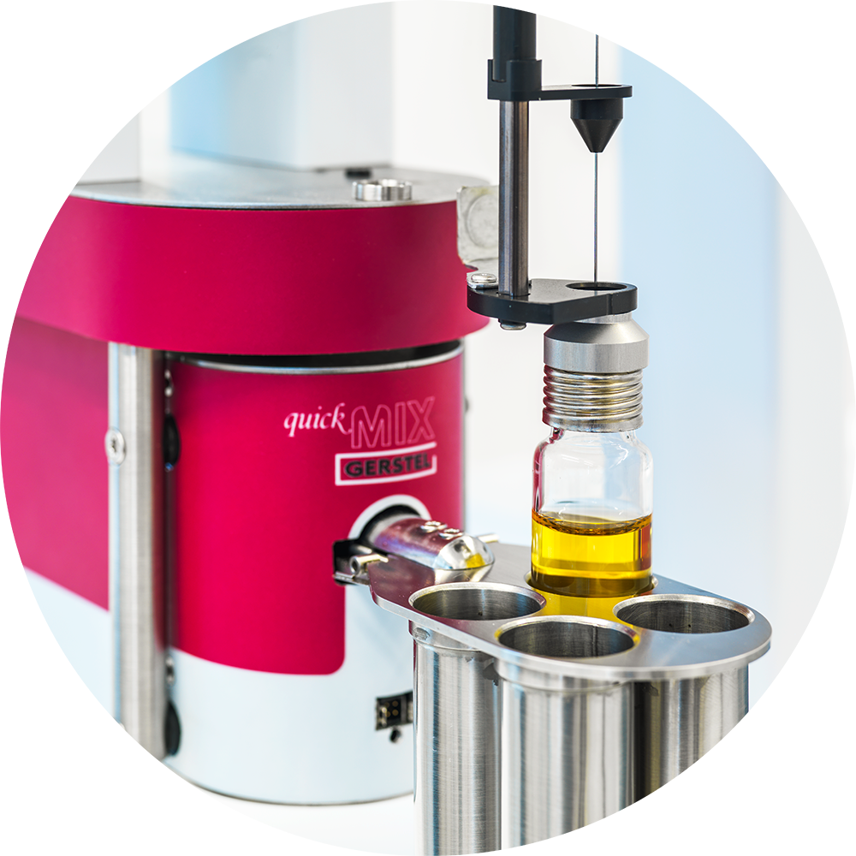
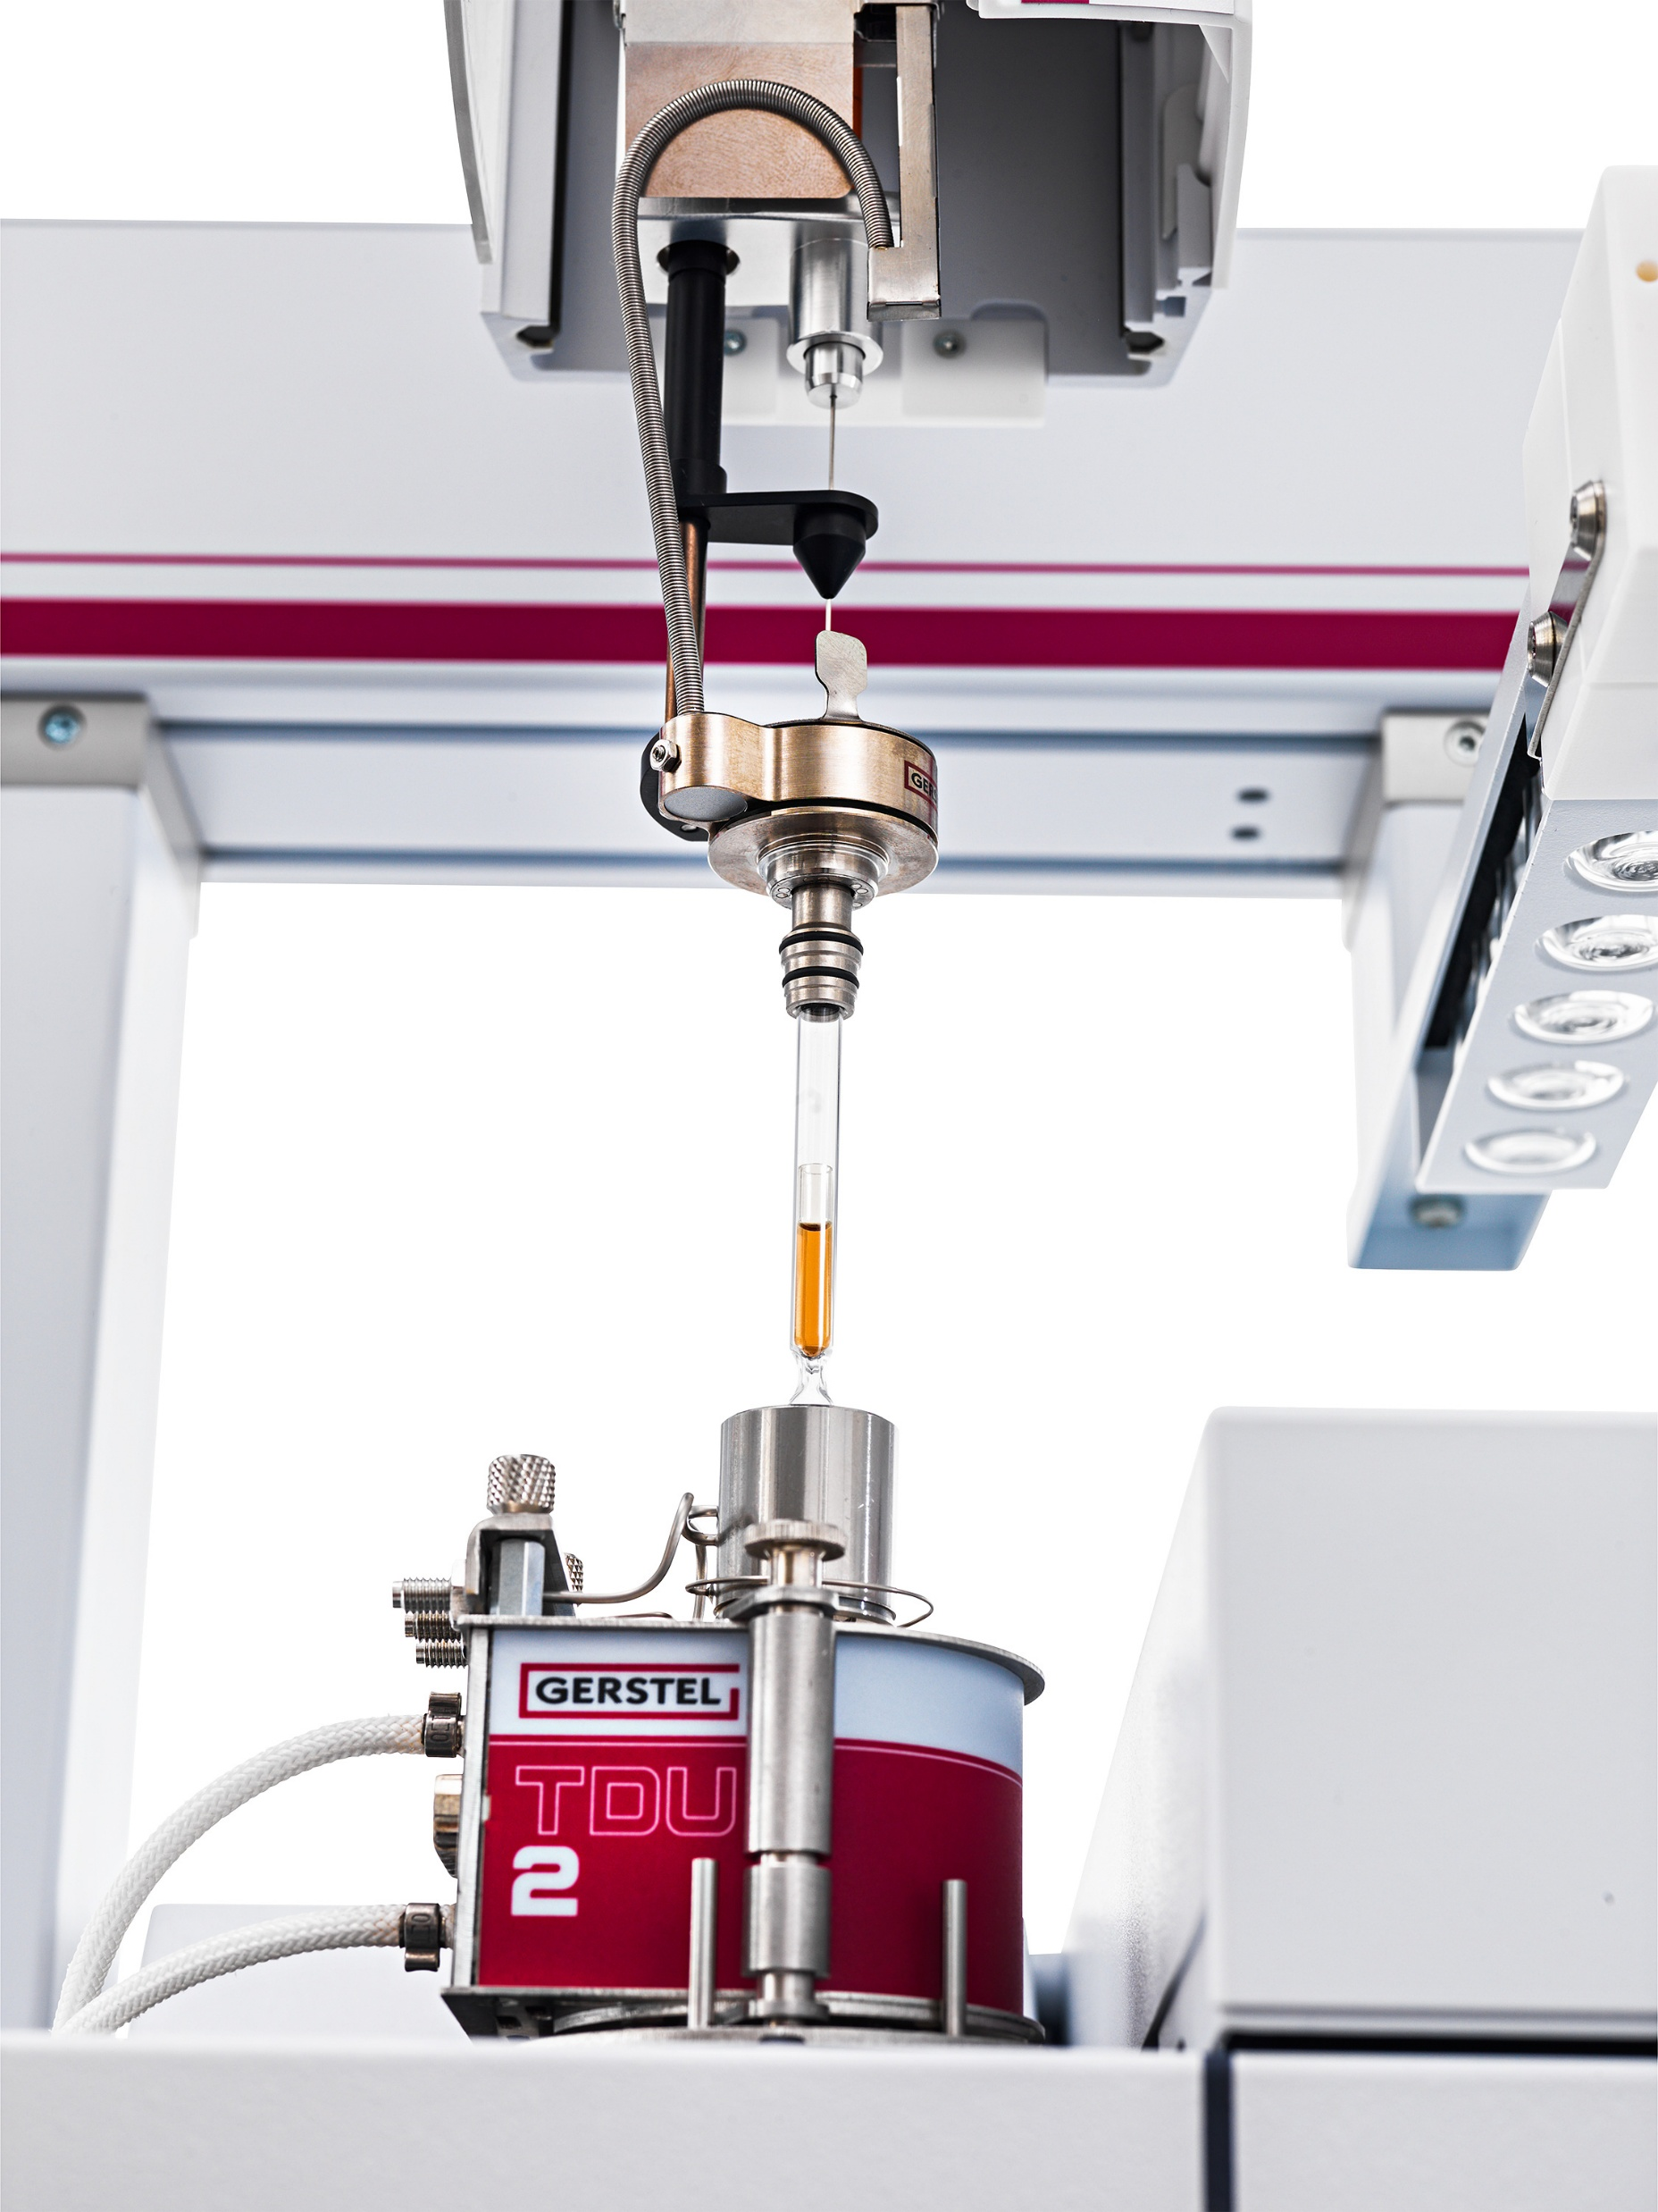

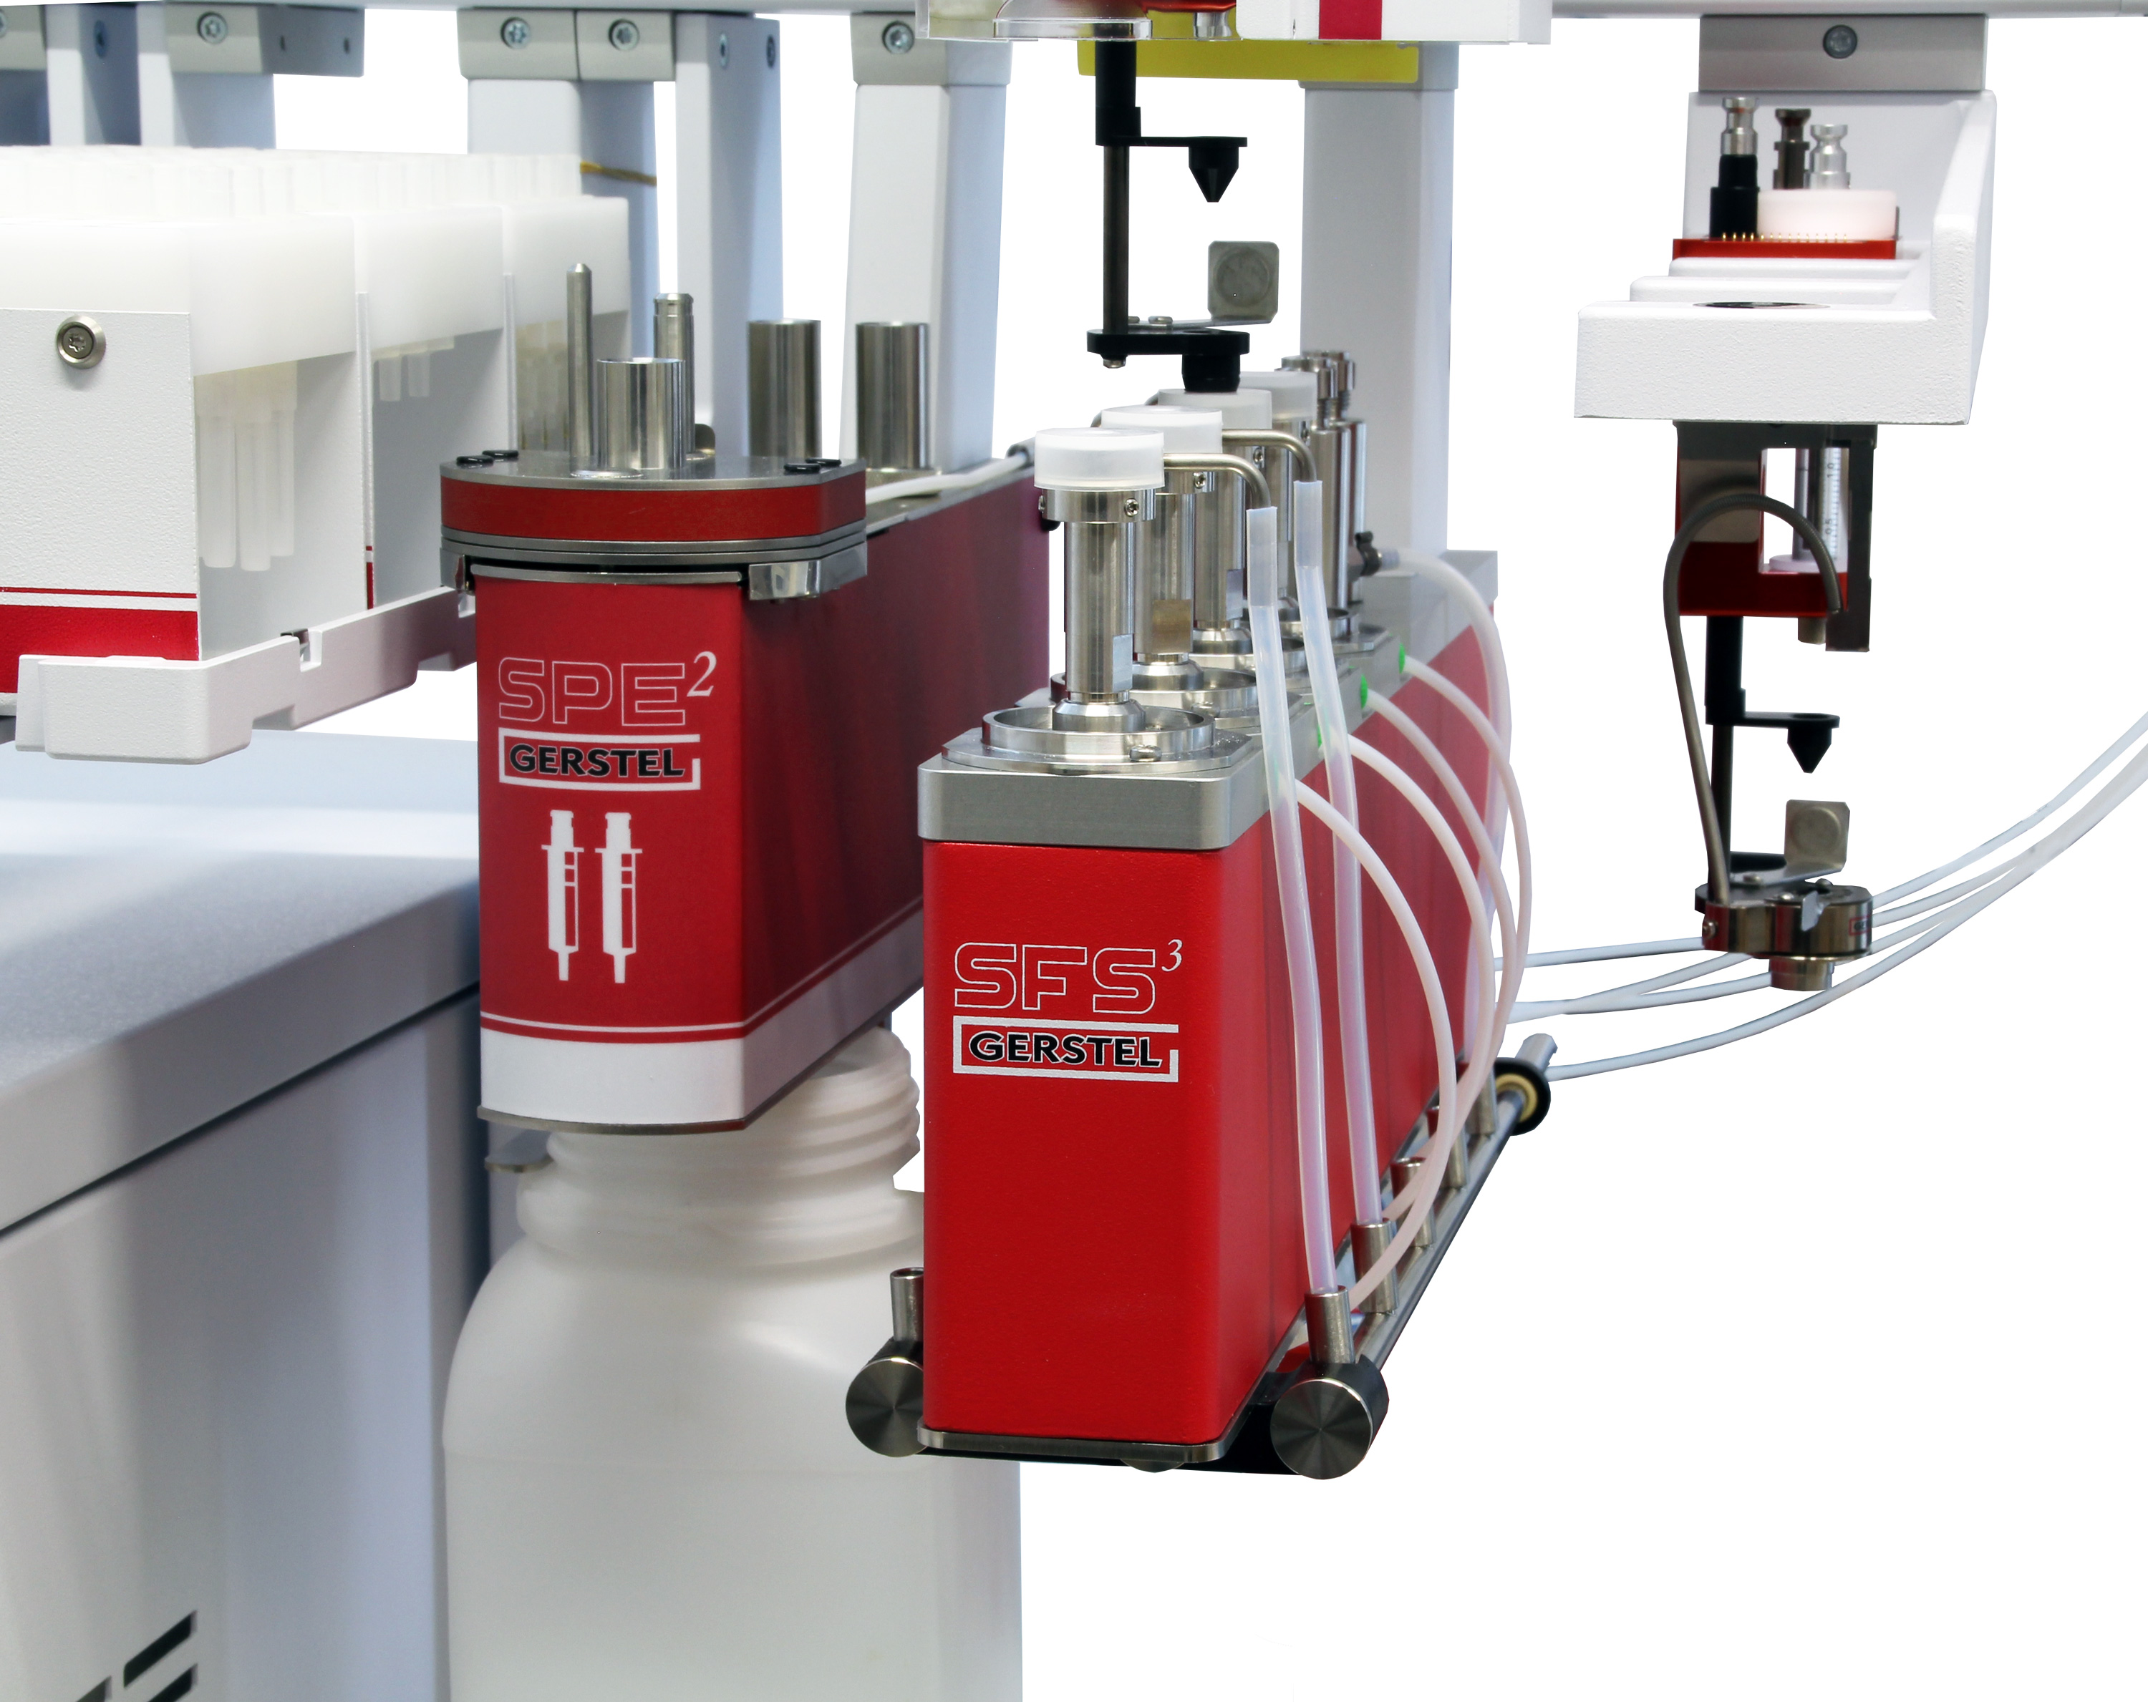
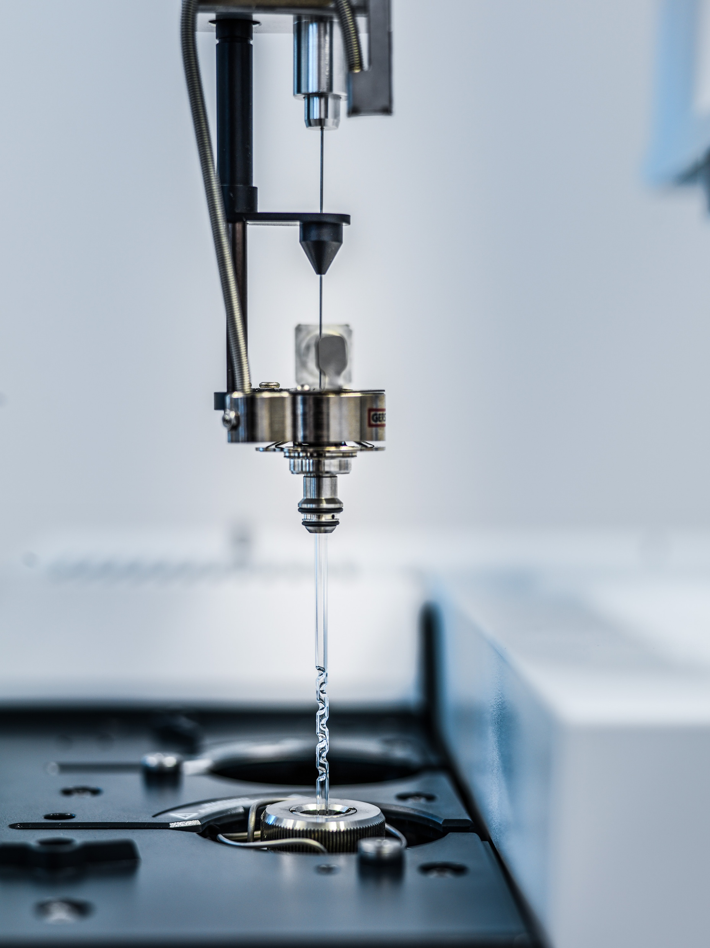
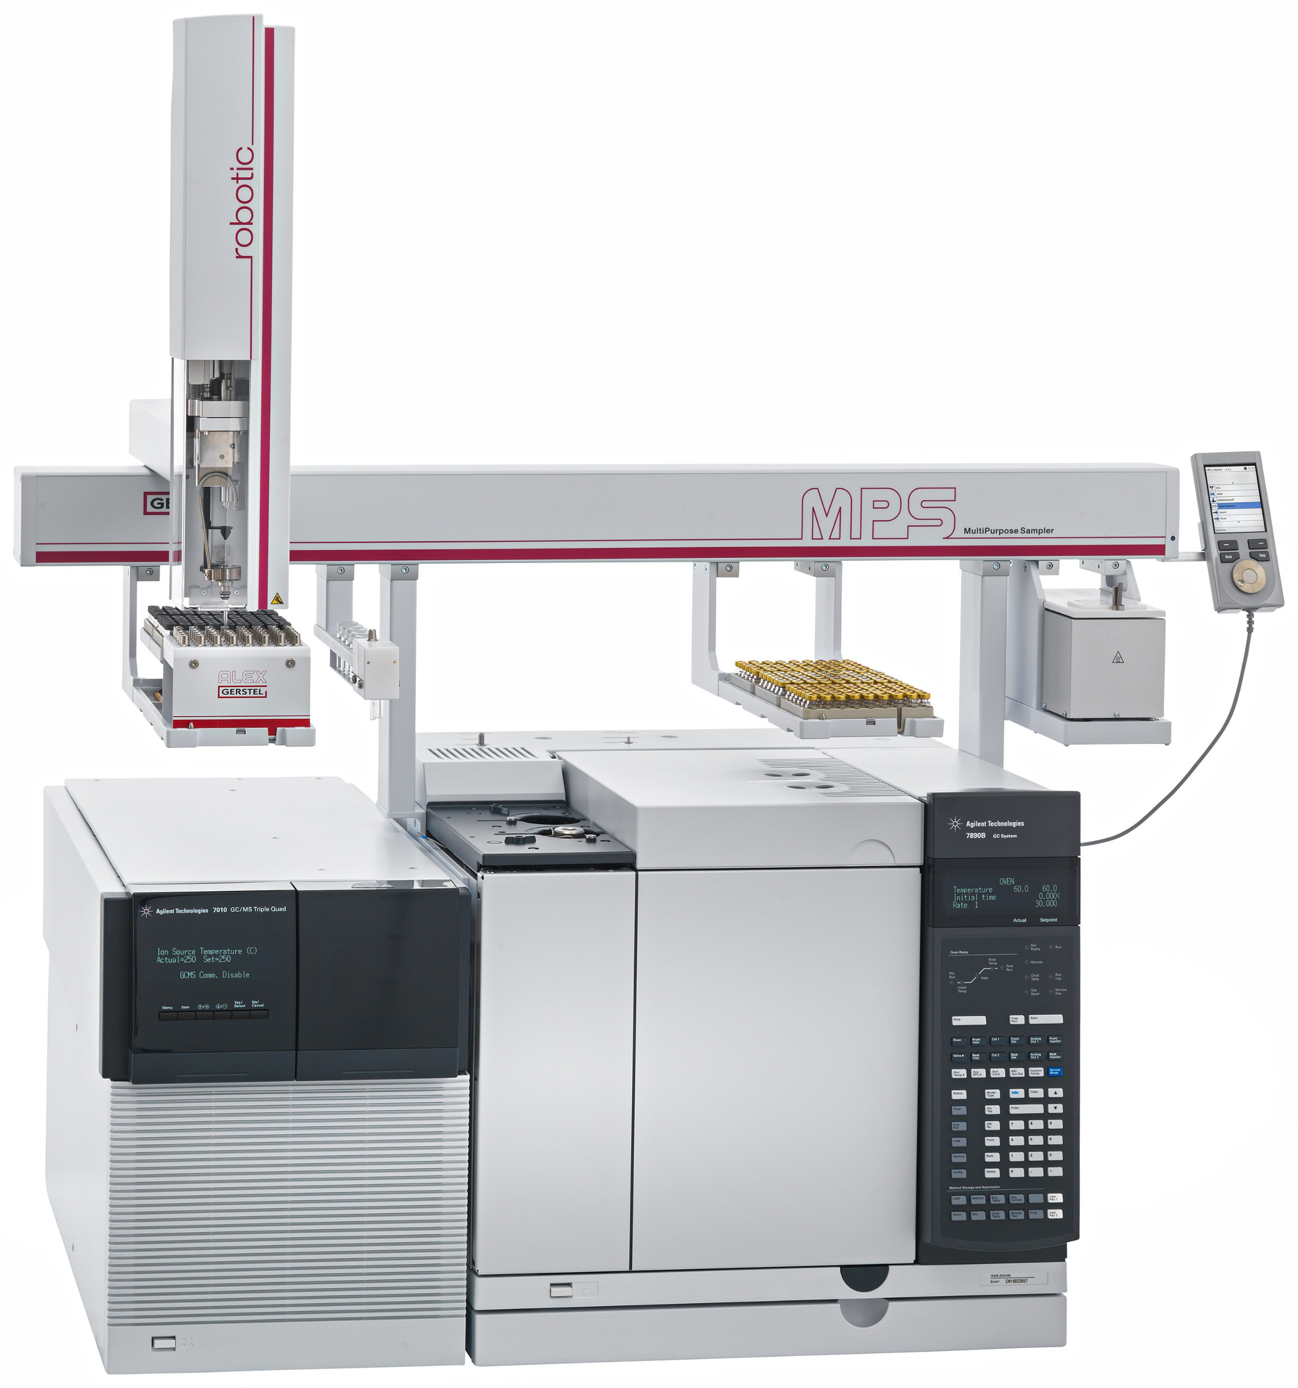
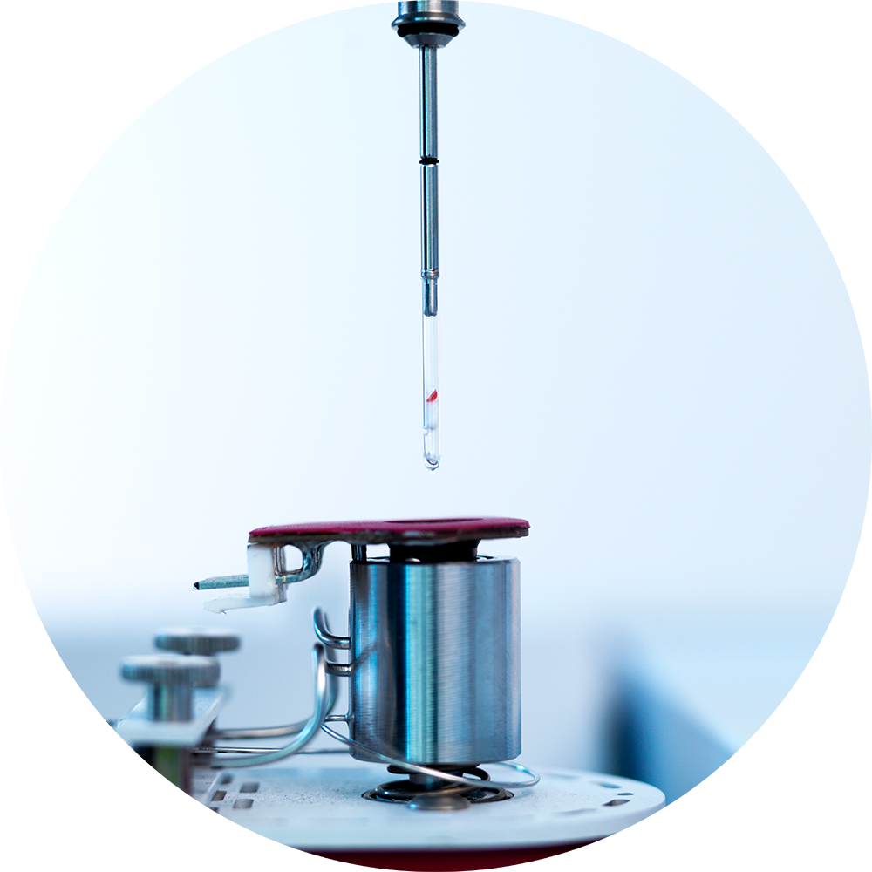
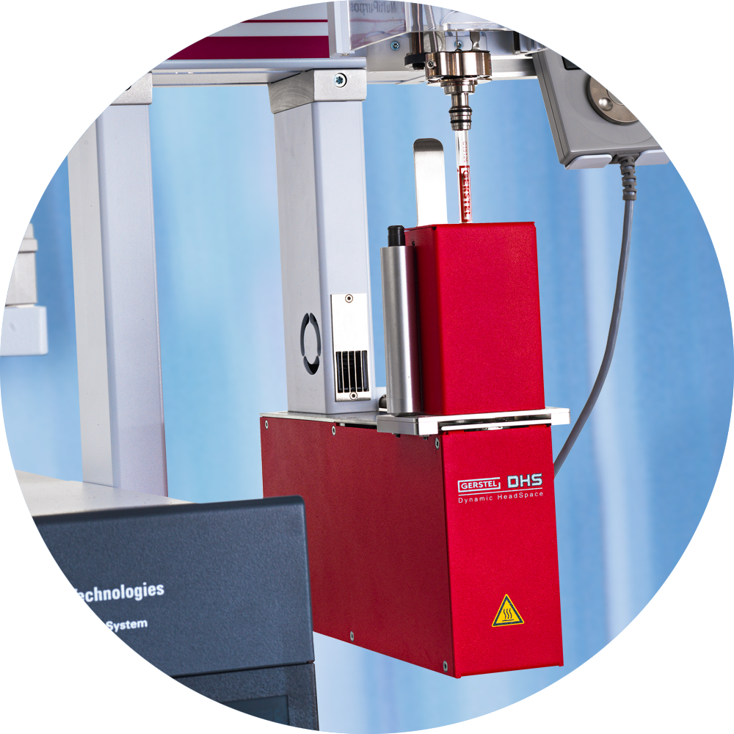
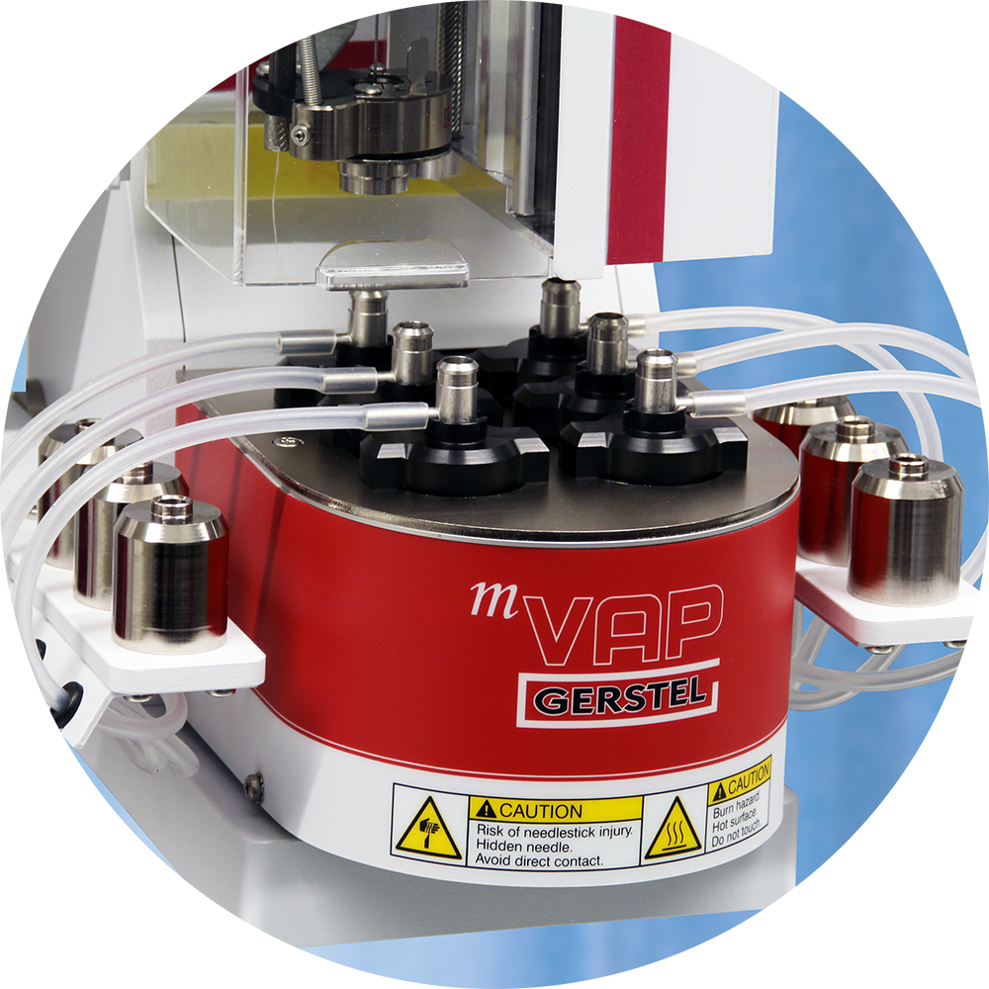
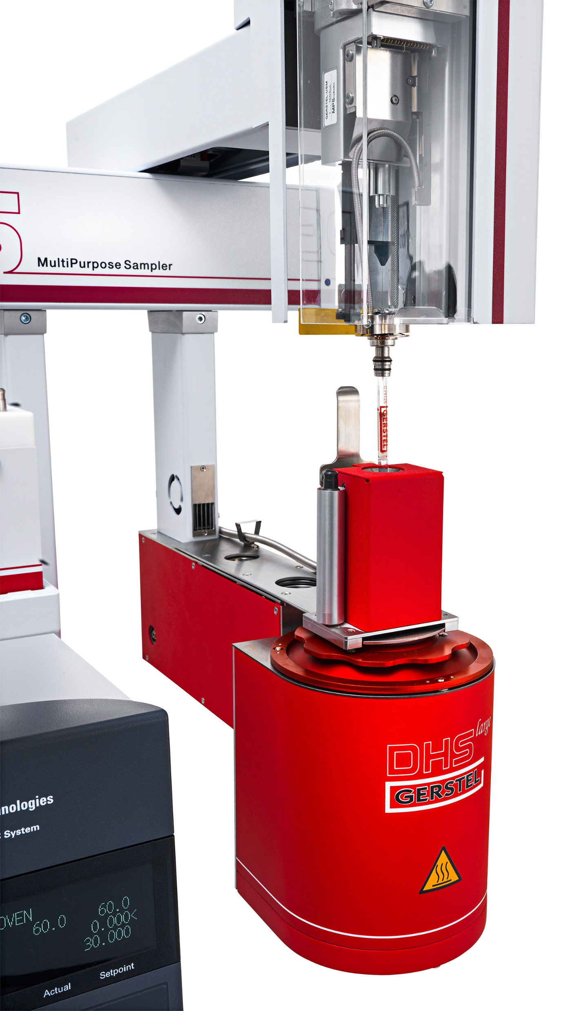
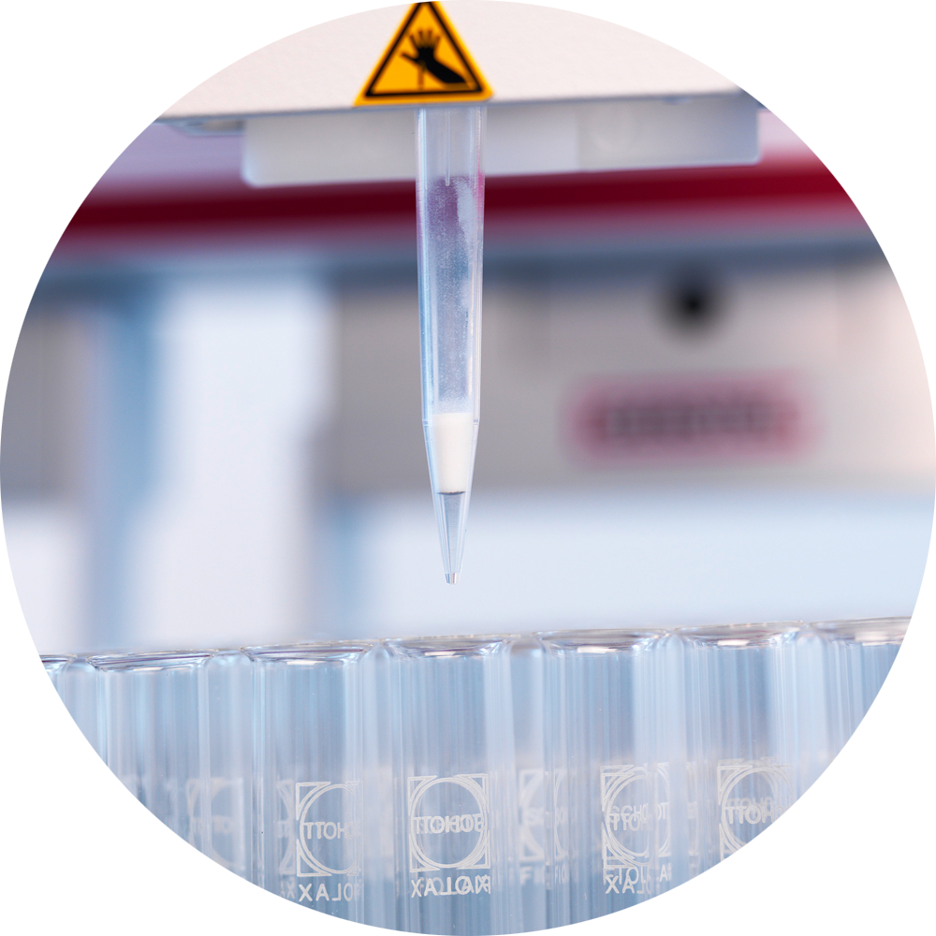
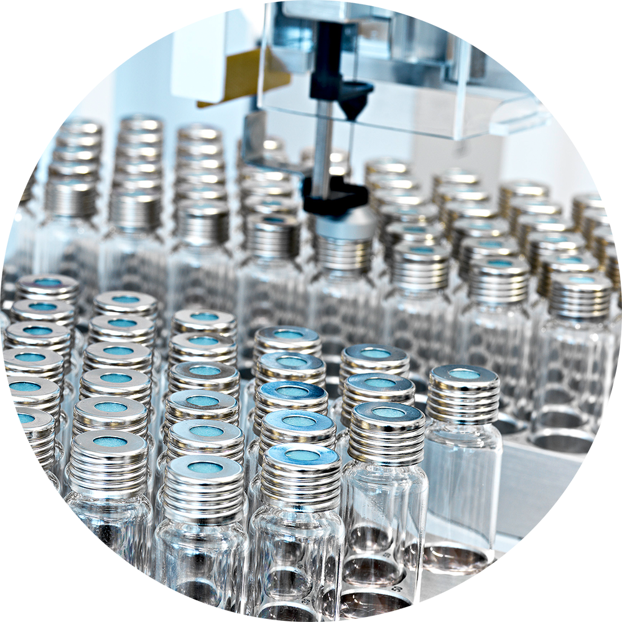
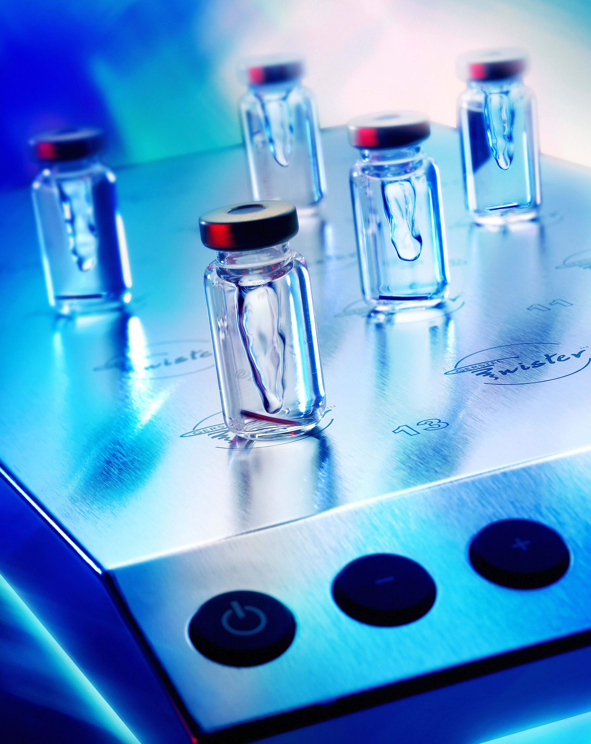
Gerstel: comprehensive solutions for sample preparation

Slide 23
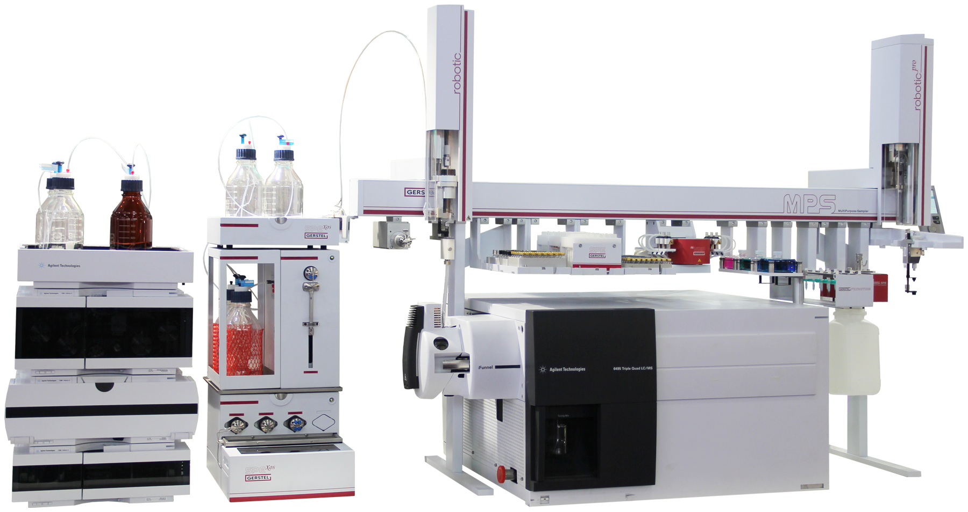
Gerstel: comprehensive solutions for sample preparation

Slide 24

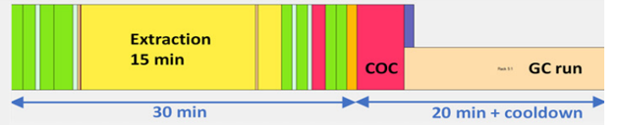
Miniaturization
Reference method (ISO28540) PAHs in water | Miniaturized and automated
1 L of water + ISTD Target LOD = 1 ng/L | 15 mL water + ISTD Target LOD = 1 ng/L => 15 pg/15 mL sample
LLE with 25 mL hexane 100% recovery = 1 ng/25 mL hexane | µLLE with 3 mL hexane 100% recovery = 15 pg/3mL hexane
Recovery of the organic phase | Recovery of the organic phase (centrifugation?)
Drying on anh. Na₂SO₄ | Transfer of 1 mL to a 2 mL vial with anh. Na₂SO₄ 100% recovery = 5 pg/1 mL
Concentration to 1 mL Final concentration: 1 ng/mL = 1 pg/µL | Vortex and centrifuge (optional) Final concentration: 5 pg/mL = fg/µL
GC-MS analysis 1 µL injection Amount on column: 1 pg | GC-MS/MS analysis 40 µL injection Amount on column: 0.2 pg
Reference method (ISO9377-2) Mineral oil in water | Miniaturized and automated
900 mL water + ISTD | 17 mL water + ISTD
LLE with 50 mL pentane | µLLE with 1 mL hexane
Shake (manually, one by one) | QuickMix (15 min)
Drying/Clean-up Na₂SO₄ & Florisil | Decap Transfer 600 µL to 2 mL vial with Na₂SO₄ & Florisil then Vortex
Concentration to 1 mL | -
GC-FID analysis 1 µL injection | GC-MS/MS analysis 100 µL injection (COC with EVE)
MS -> MS/MS
Notes:
Add MCPD!

Slide 25
Miniaturization & automation
Advantages of automation:
  Sustainable: enhanced precision, accuracy, and efficiency in laboratory processes
  Run 24/7 (unattended sample preparation or sample preparation & analysis)
  High throughput
    Combination with fast analysis
    Online and/or offline
  Low reagent consumption
  Extended application range (can be dedicated or can have several applications on a single workstation)
  Automation = more time for qualified staff for more important tasks

Slide 26
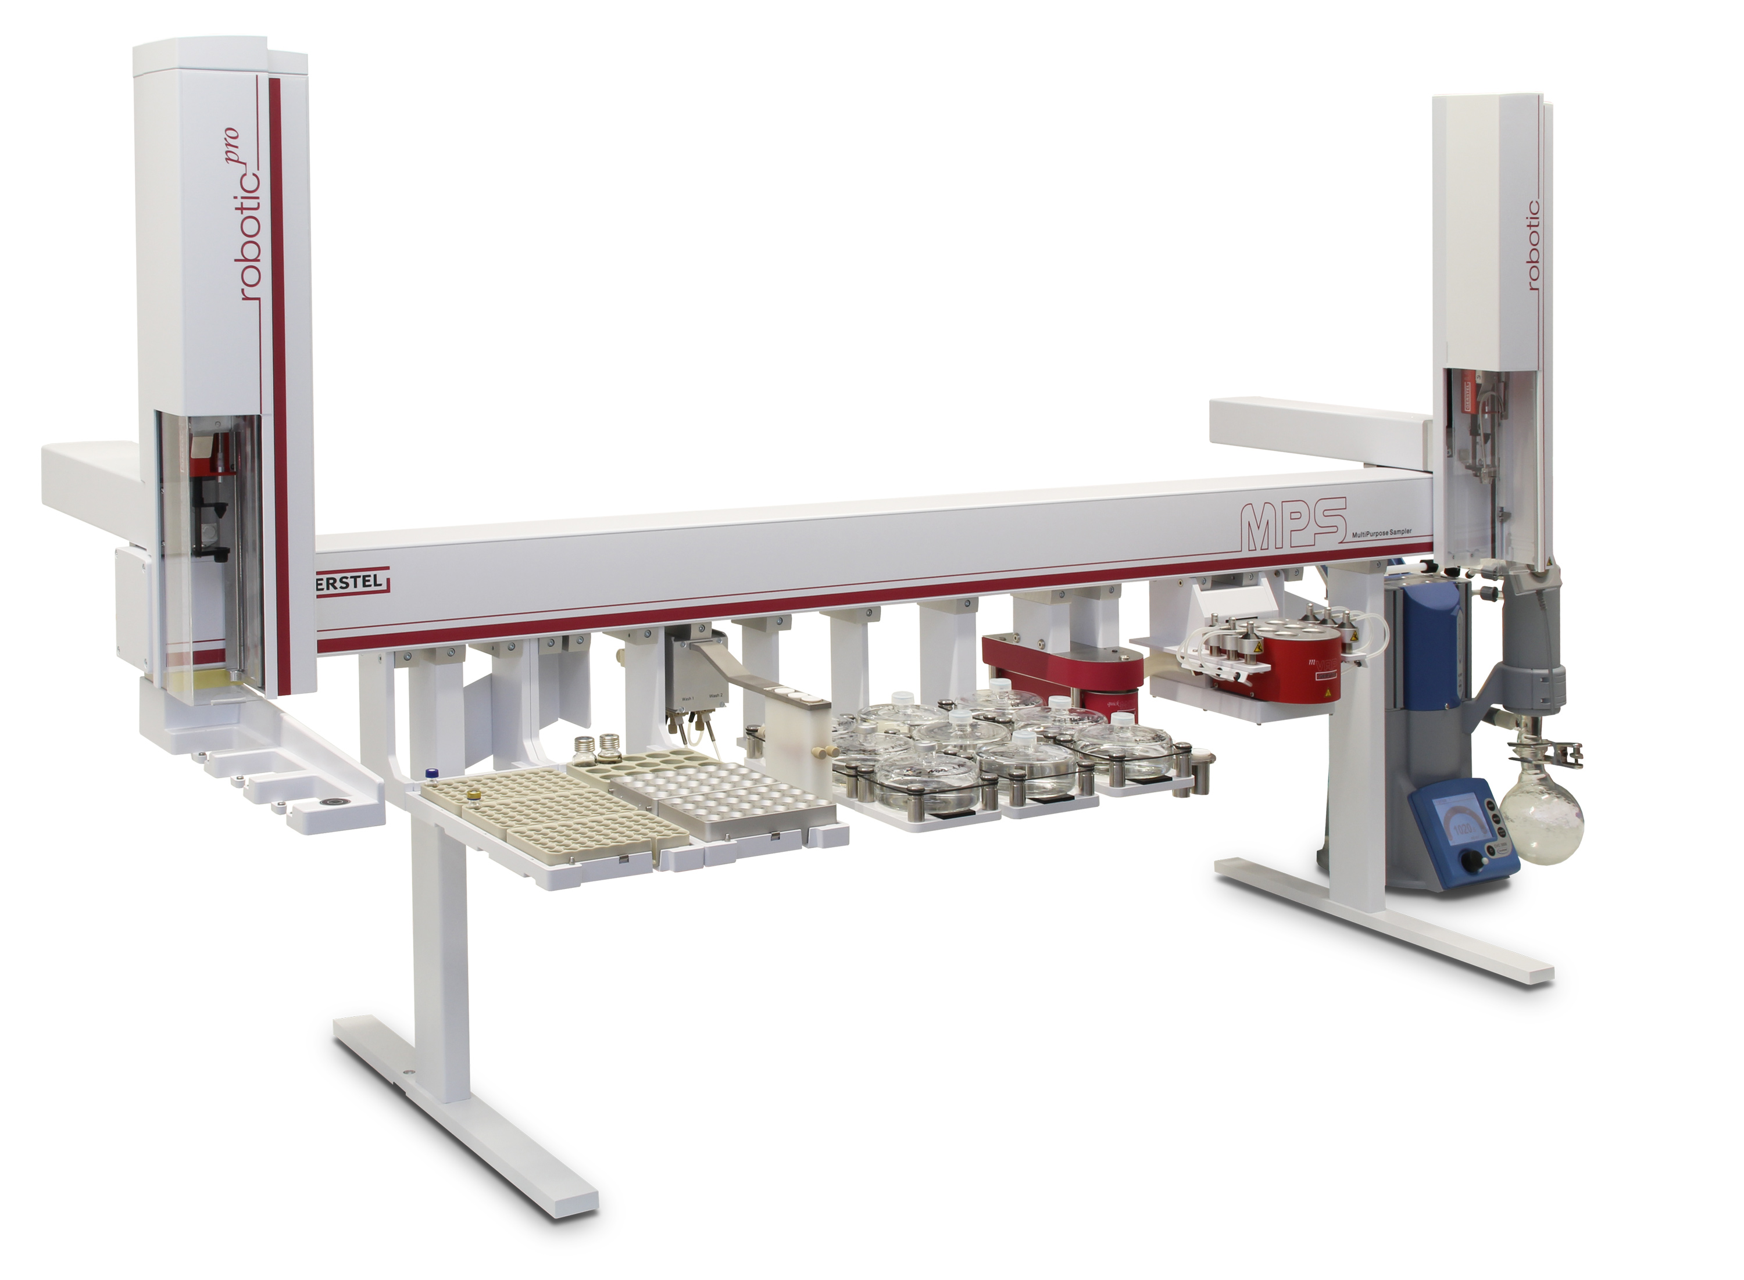
Automated sample preparation options
Offline (preparation of vials for GC and LC analysis)
  Independent from the GC and LC run time
  Batch processing
  Safety (can be placed under fume hoods, separated ventilation)
Online (including injection in GC or LC)
  “fully automated”
  “just in time” sample preparation

Slide 27
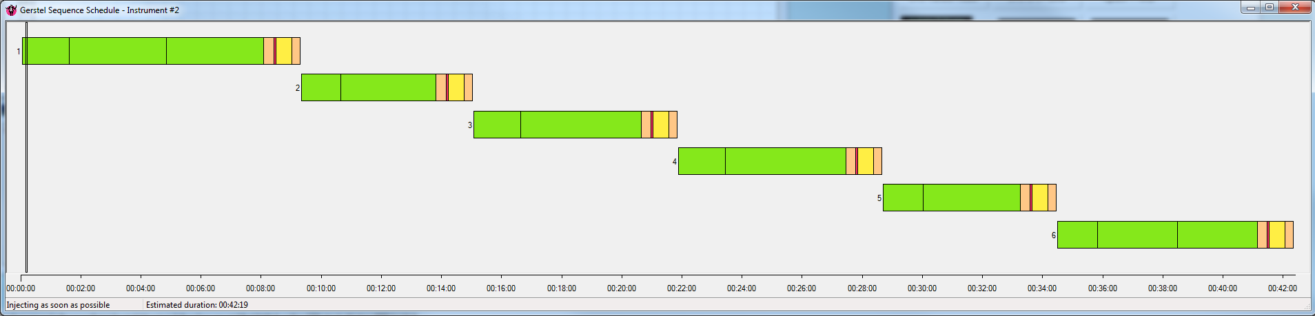
Preparation of the calibration solutions: VOC analysis in water
Preparation of the standard work solutions:
900 µL MeOH
50 µL VOC 1
50 µL VOC 2
Dilute 1/20
WS1
Dilute 1/10
WS2
Dilute 1/10
WS3
SIST 1
STD working solution preparation
WIST 1
ISTD working solution preparation

Slide 28
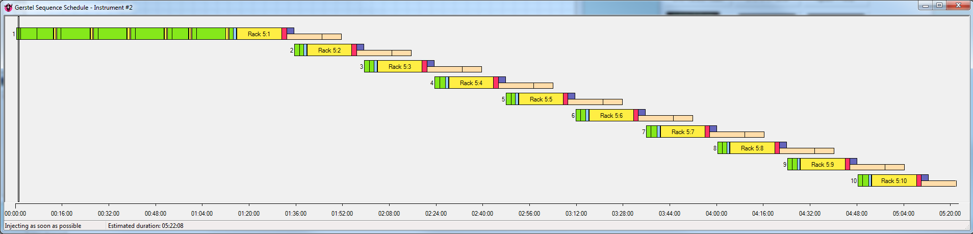
Preparation of the calibration solutions & calibration curve
Working solution
preparation
Addition of the STD/ISTD and analysis of samples and/or calibration

Slide 29
Calibration curves: VOC in water
Dichlorofluoromethane
Styrene
10 – 5000 ppt
r²=0.999
10 – 5000 ppt
r²=0.999

Slide 30
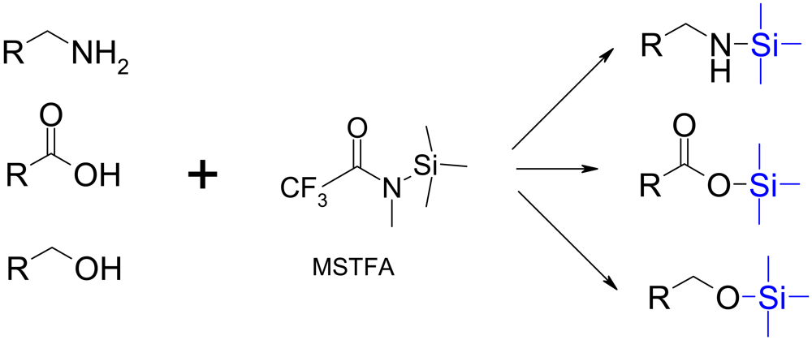

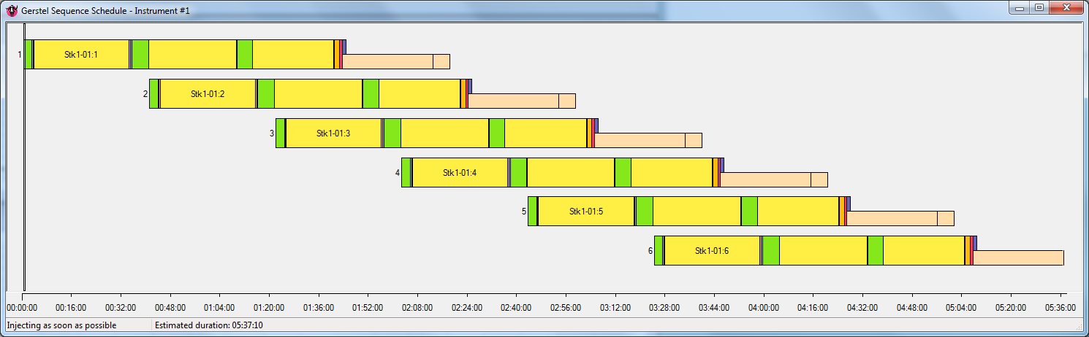
Derivatization
Organic acids in urine/metabolomics studies (Fiehn method)
  Add ISTD and evaporate to dryness
  Add MOX and incubate at 40°C
  Add MSTFA/TMCS and incubate at 40°C
  Inject
“Just in time” analysis

Slide 31

FAMEs analysis
Fatty Acids Methyl Esters:
  Food
  Biological samples
Online/Offline sample preparation and GC-FID analysis:
  ISO 16958: Using sodium methoxide (NaCH₃O)
  ISO 12966-2: Using KOH/MeOH transesterification
  ISO 12966-4: Using BF₃/MeOH

Slide 32
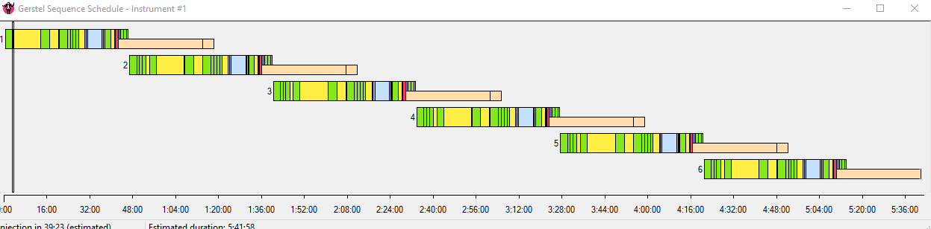
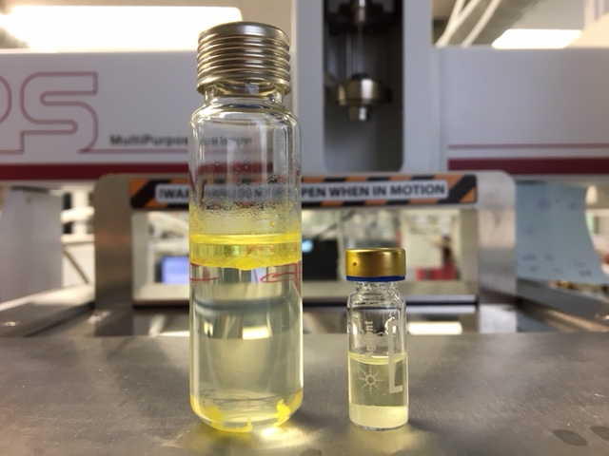
FAMEs sample preparation
50 mg fat placed in a 20 mL vial (manual work)
Add MTBE containing ISTD
Vortex
Add NaCH₃O
Vortex and wait
Add hexane (exactly 180s after the start of the reaction)
Add saturated NaCl solution
Vortex & centrifuge
Transfer hexane to a 2 mL vial with anh CaCl₂
Vortex then inject
% FAME | Certificate | BF₃ | KOH | NaOCH₃
C16:0 | 10.74 | 10.80 | 10.93 | 11.01
C18:0 | 2.82 | 2.78 | 2.78 | 2.81
C18:1c | 25.40 | 24.91 | 25.08 | 24.97
C18:2c | 54.13 | 54.73 | 54.45 | 54.48
C18:3 n3 | 3.35 | 3.21 | 3.20 | 3.18

Slide 33
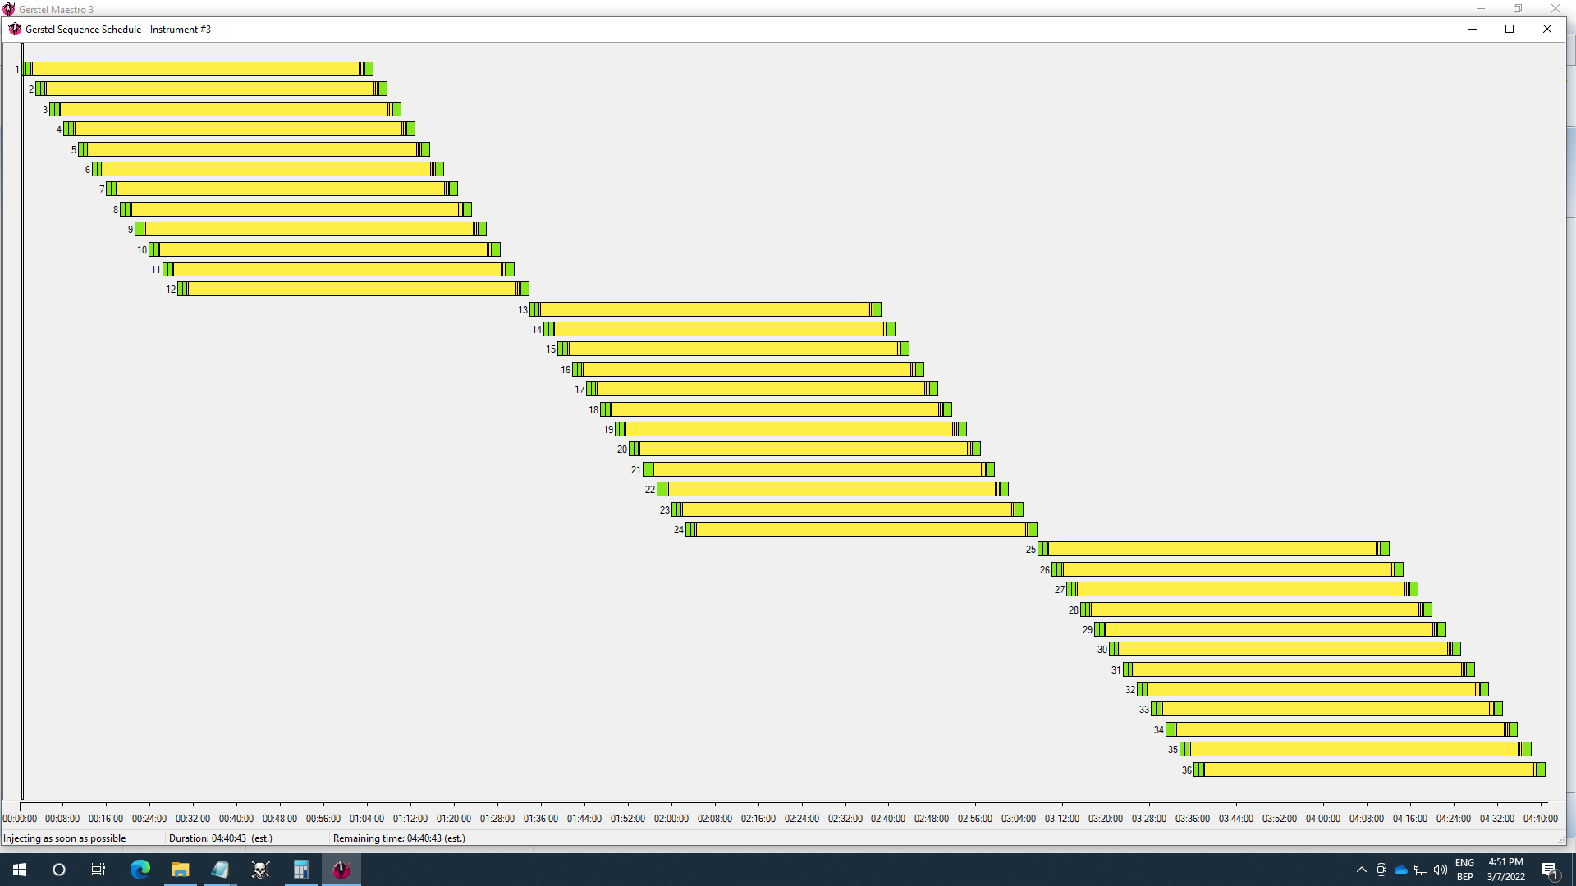
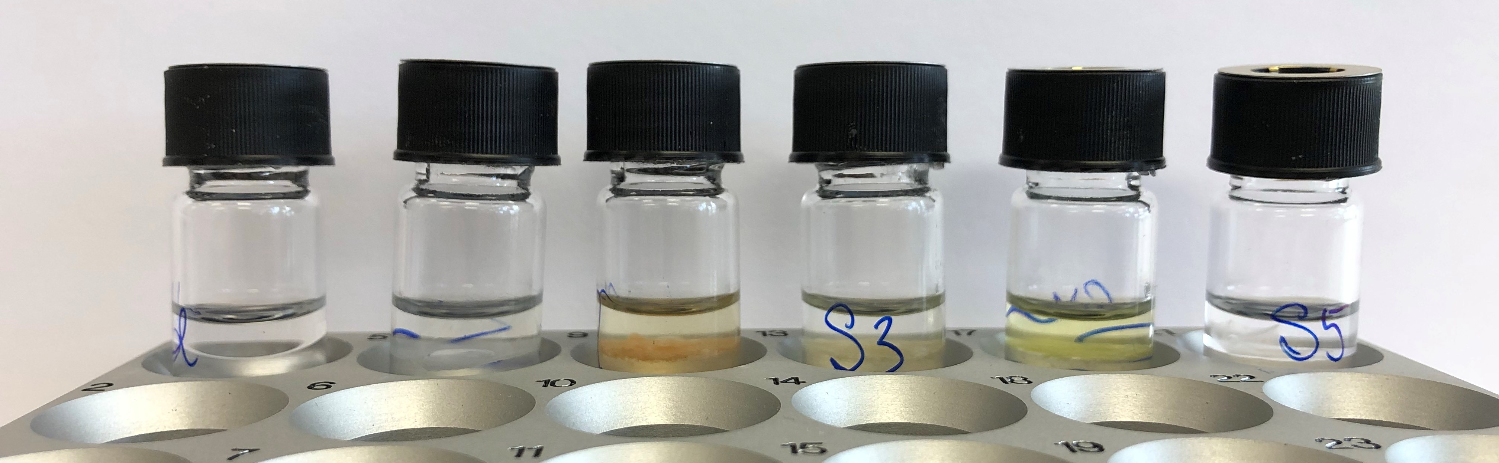
Offline FAMEs analyzer
Work in batch for increased sample throughput
Add 2 mL methylation reagent
Add 1 mL heptane
Incubate 1h in the agitator
Transfer for injection
Batch 12 samples
(2 agitators)
144 samples/24 h
70 samples/24 h

Slide 34
FAMEs in life science
Phospholipids FA analysis:
MPS Robotic Pro = 1 single configuration
Compound name | Average rel. area | RSD
C16:0 | 0.22 | 2.60
C18:0 | 0.34 | 4.05
C18:1 | 0.70 | 2.40
C18:2 | 0.37 | 1.05
C20:3, n6 | 3.91 | 5.32
C20:3, n3 | 1.90 | 2.42
2 separate workstations

Slide 35
MCPD analysis in edible oils and fats
AOCS Cd 29a-13
  Acid catalysed transesterification (16h @ 40°C)
  Quantification of 2-, 3-MCPD and glycidol in one assay
AOCS Cd 29b-13
  Mild alkaline catalysed transesterification (16h @ -25°C)
  Quantification of 2-, 3-MCPD and glycidol in two assays
AOCS Cd 29c-13
  Fast alkaline catalysed transesterification
  Glycidol determined by difference (two assays)
Zwagerman-Overman method
  Fast alkaline transesterification at 10°C (exactly 12 min!)
  Quantification of 2-, 3-MCPD and glycidol in one single analysis
Preparation of calibration curves and sample analysis
  The only manual step: weigh 100 mg sample in a vial
Improved robustness:
  Addition of evaporation step to remove excess PBA reagent
  Injection via PTV (low temperature injection + LVI option)
  Pre-column backflushing for limited downtime due to column & source maintenance

Slide 36
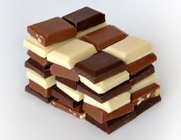
All in one?

Slide 37

Aroma analysis
Solvent Assisted Flavor Extraction (SAFE) and GC-FID or GC-MS analysis
  Vacuum distillation -> cold trapping
  Time consuming, labor intensive, prone to formation of artifacts
  Use of toxic solvents (including dichloromethane, pentane, diethyl ether)
SPME analysis
  Lacks sensitivity and discrimination
Picture: https://research.reading.ac.uk/flavourcentre/flavour-analysis/flavour-extraction-techniques/

Slide 38

Alternatives
Dynamic Headspace Sampling:
  Solventless extraction technique
  Continuous purging of headspace (sample) at controlled temperature for controlled time at controlled flow.
  Trapping of volatile organic compounds (adsorbent, sorbent, 20 °C – 70 °C)
  Thermal desorption of the compounds from the trap
  Goal: “exhaustive” extraction = highest sensitivity

Slide 39
SAFE vs DHS: food aroma analysis
SAFE extract
DHS
Repeatability (n=5)

Slide 40

SAFE vs SPME vs DHS: food aroma analysis

Slide 41



VOC sampling from living plants: DHS large or active sampling

Slide 42

DHS Large
Packaging material – 150°C

Slide 43




Automated maintenance
Automated liner exchange (ALEX):
  QuEChERS extracts: insufficient cleaning
PTV injector with ALEX option:

Slide 44

Automated maintenance
Automated liner exchange:
  Every 5 samples

Slide 45
Conclusions
Take advantage of state-of-the-art GC and MS
Miniaturization <–> automation benefits:
  Reduced solvent consumption and waste production, increased productivity, safer
But…
  Sampling must be reconsidered in function of (automated) sample prep
  There is a minimum sample amount required for reliable analysis (sample homogeneity)
    Balance between miniaturization and experimental reliability is key
  New methods should be compared to existing ones and properly validated (certified materials, proficiency tests, demonstrate equivalence)
  Intuitive software interfaces for easy and user-friendly operation for users with varying levels of expertise (introduction in production sites)

Slide 46

The future of sample preparation
Complete turnkey solutions:
  From sampling, to sample preparation, to aquisition, to analysis, to reporting all automated
Simplification through further innovation (more sustainable in less time)

Slide 47


Acknowledgements
Organizing committee
Our colleagues at RIC group
Our partners & customers

